Slide 1
21CSC201J DATA STRUCTURES AND ALGORITHMS UNIT-4 Topic :Hashing and collision

Slide 2
Hashing and collision-unit 4

Slide 3
hashed search
This is the goal of a hashed search: to find the data with only one test.
In a hashed search, the key, through an algorithmic function, determines the location of the data.
Hashing is a key-to-address mapping process.

Slide 4
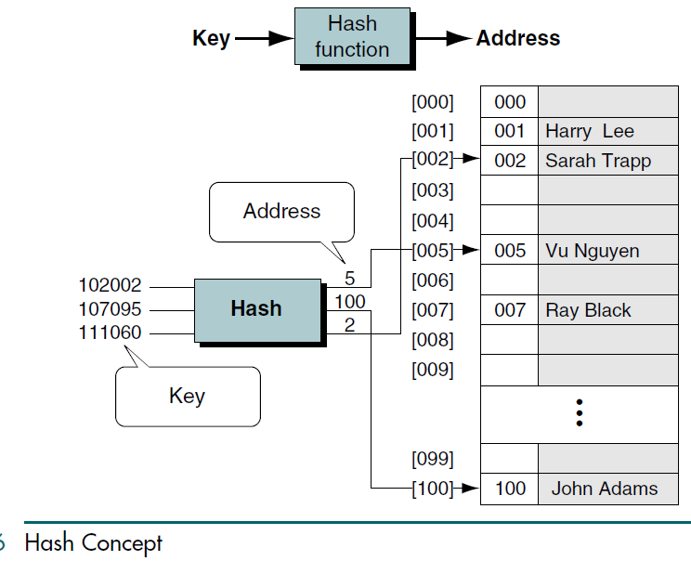

Slide 5
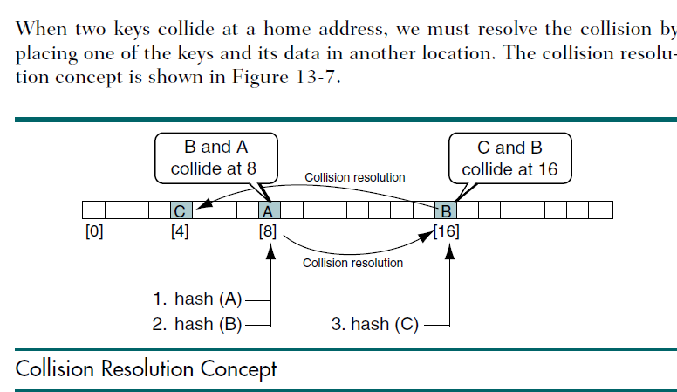

Slide 6
we hash key A and place it at location 8 in the list.
At some later time, we hash key B, which is a synonym of A.
Because they are synonyms, they both hash to the same home address and a collision results.
We resolve the collision by placing key B at location 16.
When we hash key C, its home address is 16. Although B and C are not synonyms, they still collide at location 16 because we placed key B there when we resolved the earlier
collision.
We must therefore find another location for key C, which we place
at location 4.

Slide 7
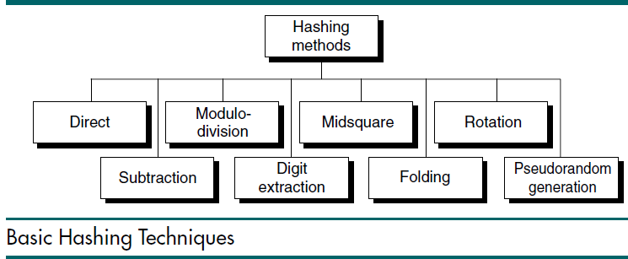

Slide 8
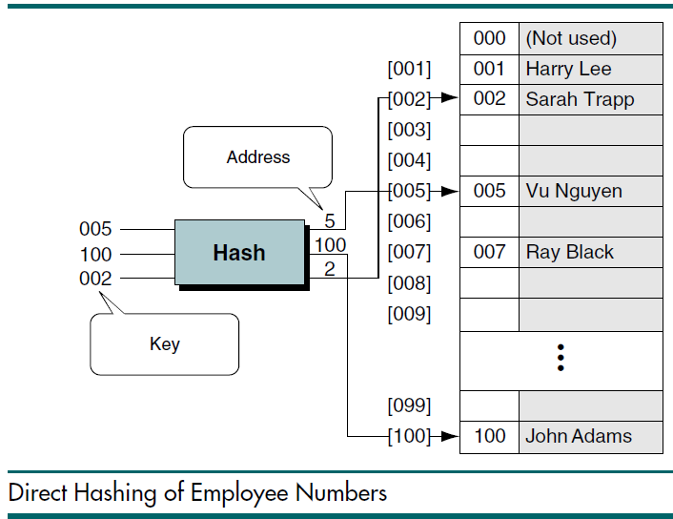

Slide 9
Subtraction Method
The direct and subtraction hash functions both guarantee a search effort of one with no collisions. They are one-to-one hashing methods: only one key hashes to each address
For example, a company may have only 100 employees, but the employee numbers start from 1001 and go to 1100. In this case we use subtraction hashing, a very simple hashing function that subtracts 1000 from the key to determine the address.
The beauty of this example is that it is simple and guarantees that there will be no collisions.

Slide 10
Modulo-division Method
address = key MODULO listSize
we want to provide data space for up to 300 employees. The first prime number greater than 300 is 307. We therefore choose 307 as our list (array) size,
which gives us a list with addresses that range from 0 through 306.

Slide 11
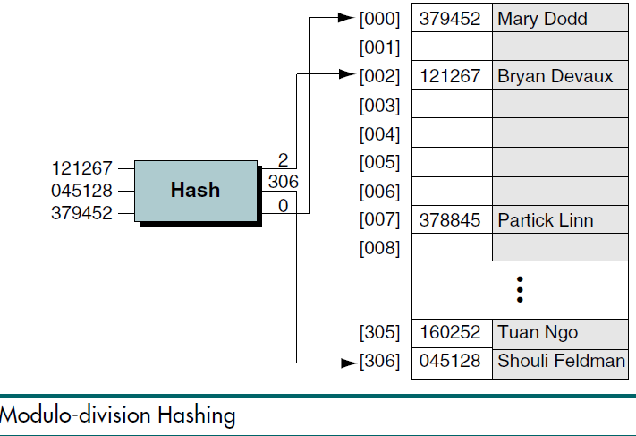
121267/307 = 395 with remainder of 2
Therefore: hash(121267) = 2

Slide 12
Digit extraction method & mid square method
1. using Digit extraction method (1,3,6 digits )find the address for the following key values
a) 0 4 5 3 5 6 = 0 5 6
b) 7 8 9 5 6 3
c) 8 9 4 2 1 0
2. using mid square method find the address for the following key values
a) 9 4 5 2= 9452 X 9452= 89340304 =3403
b) 7 8 9 5
c) 8 9 4 2

Slide 13
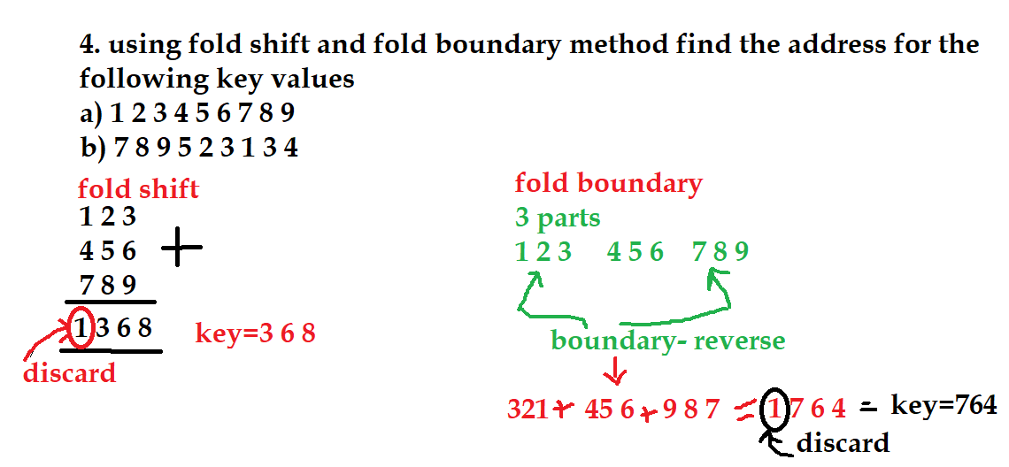

Slide 14
rotation hashing method
using rotation hashing method find the address for the following key values
a) 500110 =050011
b)500111= 150011
c)500112
d)500113

Slide 15
pseudorandom hashing method
using pseudorandom hashing method find the address for the following key
pseurandom number generator is y=a x + c
let a=17 c=7
list size=307
key= x= 121267
address= ( a x + c) modulo listsize

Slide 16
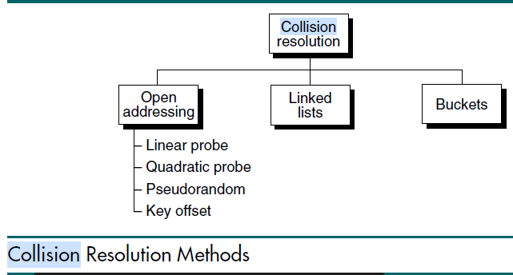

Slide 17

first concept: load factor
The load factor of a hashed list is the number of elements in the list divided by the number of physical elements allocated for the list, expressed as a percentage.
Traditionally, load factor is assigned the symbol alpha (α).
The formula in which k represents the number of filled elements in the list and
n represents the total number of elements allocated to the list is

Slide 18
second concept :Clustering
As data are added to a list and collisions are resolved, some hashing algorithms tend to cause data to group within the list.
This tendency of data to build up unevenly across a hashed list is known as clustering,
As data are added to a list and collisions are resolved, some hashing algorithms tend to cause data to group within the list.
This tendency of data to build up unevenly across a hashed list is known as clustering,
Secondary clustering occurs when data become grouped along a collision path throughout a list.

Slide 19
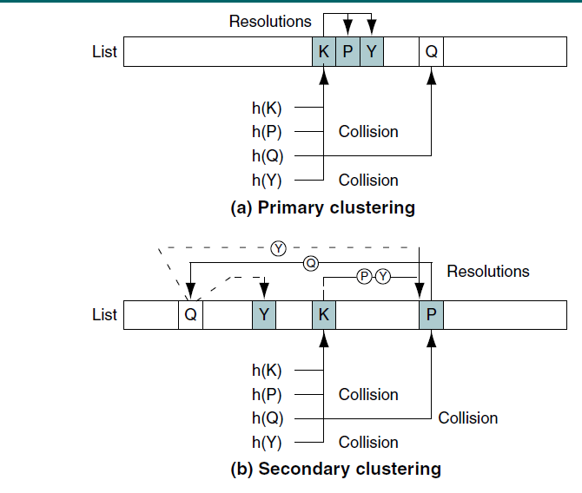
design
hashing algorithms to minimize clustering, both primary and secondary.

Slide 20
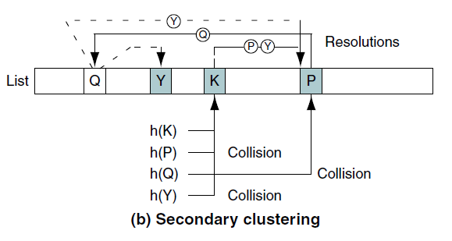
Assume that we have a hashing algorithm that hashes each key to the same home address.
Locating the first element inserted into the list takes only one probe. Locating the second element takes two probes.
Carrying the analogy to its conclusion, locating the nth element added to the list takes n probes, even if the data are widely distributed across the addresses in the list

Slide 21
three difficulties
the number of elements examined in the search for a place to store the data must be limited.
First, the search is not sequential, so finding the end of the list doesn’t mean that every element has been tested.
Second, examining every element would be excessively time-consuming for an algorithm that has as its goal a search effort of one.
Third, some of the collision resolution techniques cannot physically examine all of the elements in a list.
Computer scientists therefore generally place a collision limit on hashing
algorithms.

Slide 22
Linked List Collision Resolution
A linked list is an ordered collection of data in which each element contains the location of the next element
Linked list collision resolution uses a separate area to store collisions and chains all synonyms together in a linked list. It uses two storage areas:
the prime area and the overflow area.
Each element in the prime area contains an additional field—a link head pointer to a linked list of overflow data in the overflow area.
When a collision occurs, one element is stored in the prime area and chained to its corresponding linked list in the overflow area.

Slide 23
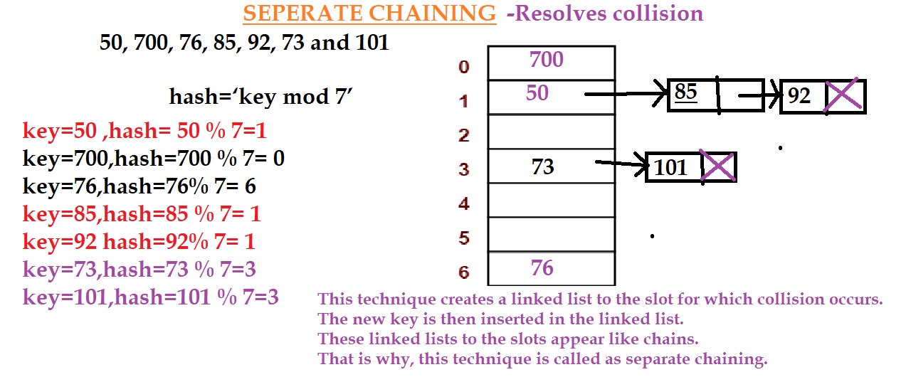

Slide 24
Open Addressing
The first collision resolution method, open addressing, resolves collisions in the prime area—that is, the area that contains all of the home addresses
When a collision occurs, the prime area addresses are searched for an open or unoccupied element where the new data can be placed.

Slide 25
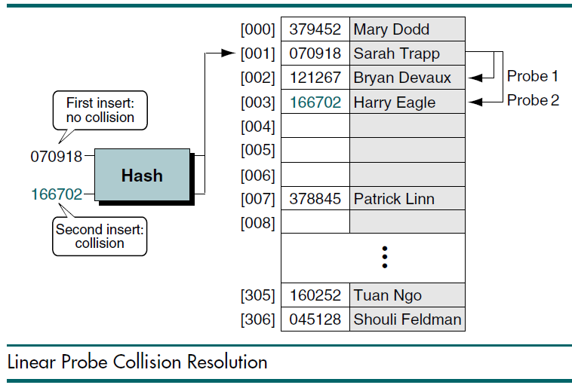
Linear Probe
In a linear probe, which is the simplest, when data cannot be stored in the home address we resolve the collision by adding 1 to the current address.

Slide 26
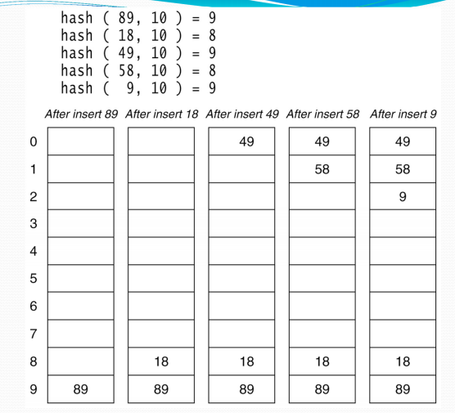

Slide 27
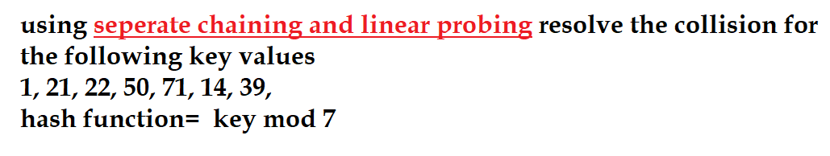
Practice Question

Slide 28
Quadratic Probing
In open addressing scheme, the actual hash function h(x) is taking the ordinary hash function h’(x) and attach some another part with it to make one quadratic equation.
h´ = (𝑥) = 𝑥 𝑚𝑜𝑑 𝑚
ℎ(𝑥, 𝑖) = (ℎ´(𝑥) + 𝑖²)𝑚𝑜𝑑 𝑚
The value of i = 0, 1, . . ., m – 1. So we start from i = 0, and increase this until we get one free space. So initially when i = 0, then the h(x, i) is same as h´(x).

Slide 29
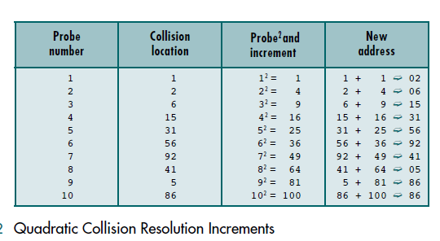

Slide 30
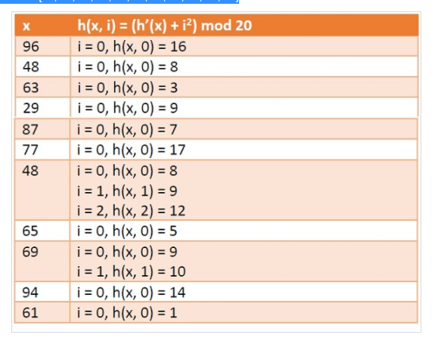

Example
we have a list of size 20 (m = 20). We want to put some elements in linear probing fashion.
The elements are
{96, 48, 63, 29, 87, 77, 48, 65, 69, 94, 61}

Slide 31
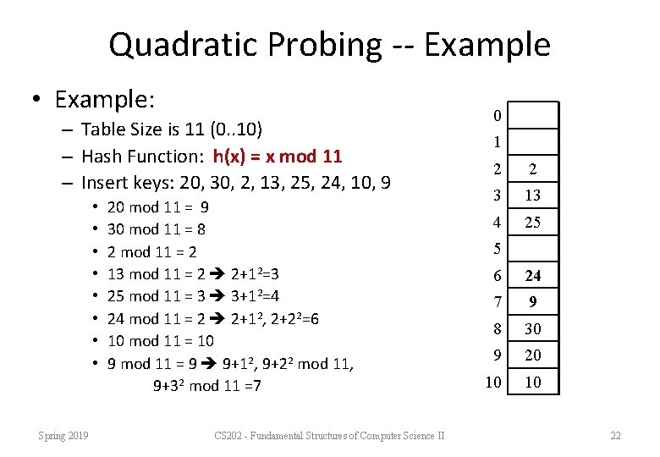

Slide 32
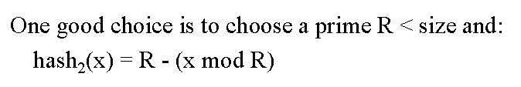
Double Hashing
The last two open addressing methods are collectively known as double hashing
To resolve collision, the address is rehashed.

Slide 33
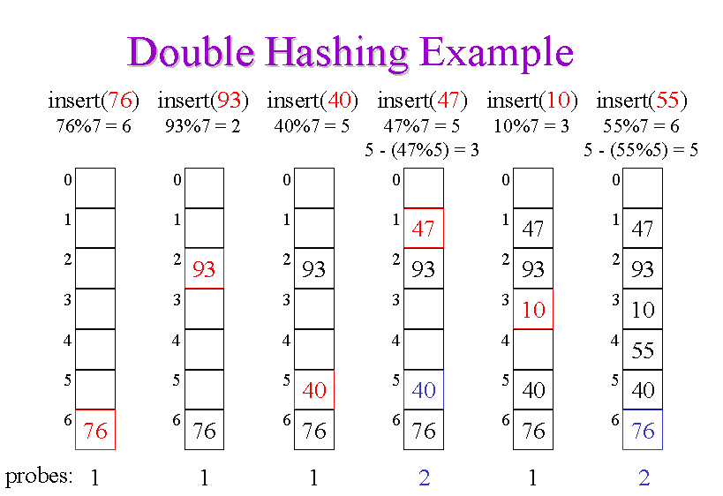

Slide 34


Key Offset
Key offset is a double hashing method that produces different collision paths for different keys.
Whereas the pseudorandom-number generator produces a new address as a function of the previous address, key offset calculates the new
address as a function of the old address and the key.

Slide 35
